Slide 1

Hillcrest Lakers
3rd-8th graders AYSO

Slide 2
Thank you for volunteering your time! A couple of important things within this powerpoint. Please take your time to read through. Please contact us with any concerns/questions -
Linda Edge - (352) 318-9393
Kelly Murphy - (914) 999-0432

Slide 3
Important notes -
Confirm your game with the other coach a few days prior to the game.
Do not cancel any games, please ask your team if another parent can coach.
Please have your team show up at least 15 minutes before scheduled time. (My team shows up 30-45 minutes before). The scheduled time is when the game kicks off. It should not be the time when players arrive at the field.
Linda will reach out each week with any home game information such as set up of goals, corner flags etc.

Slide 4
Rules
Changes/Cancellations
  Coaches may not unilaterally cancel a match without the expressed approval of their Regional Commissioner. The Regional Commissioners of the opposing Regions must agree to cancel a match. Rain is not cause for cancellation, unless the field owner closes the field. Soccer is played outdoors; there will be hot days, cold days, windy days and rainy days.
Re-Confirming Games
  Coaches should reach out to opposing coach a few days before their scheduled match. Confirm the following: Referee availability, field location and time, directions, color of kits, no pets. DO NOT move games to different fields or times unless approved by both Regional Commissioners and Area 3T Director.

Slide 5
Short Players
  f you are short players inform opposing coach and mix up teams, do not cancel matches, parents and players expect to play every Sunday.
Coach unavailable
  If you are unavailable to coach your team that day DO NOT cancel the match, inform your Division Coordinator and Regional Commissioner, they will find a replacement
No Ref
  In the event there is no referee present, take preparations beforehand, and bring a whistle, a yellow jersey. Coaches can split field and referee together. Bring different colored pinnies as well.
Start and End on Time

Slide 6
Rules
AYSO has National rules that are up to date here.

Slide 7
Substitution Rules
There is no "quarter" water break however teams may perform a sideline substitution half way through each half. The referee will stop the game at an appropriate moment to allow subs but will not stop the clock. Thus Coaches must have subs ready to go or they will lose game clock time and potentially provide less playing time to their second quarter players than their first quarter players if their substitution is extended. Again, this is not a water break, or halftime, it is a substitution break (though a sip of water does happen occasionally).
  U10: 25 minute halves, ref should be looking for a stoppage to allow subs between 11-12 minute mark. Coaches should keep the changeover of players to about 2-3 minutes.
  U12: 30 minute halves, ref should be looking for a stoppage to allow subs between the 13-14 minute mark. Coaches should keep the changeover of players to about 2-3 minutes.
  U14 and U19: Shall utilize rolling subs as the game is longer and the match is full sided.

Slide 8
Blowout Rules
It is an excess of a six goal differential that defines a blowout:
  5-0 is OK (coaches should have already had a discussion at 3 or 4 goal difference)
  6-0 is OK (but is the limit)
  7-0 is a blowout and is unacceptable.
Proper planning should be undertaken by the coaches to avoid a blowout. Reference Guidelines for Blowouts for more tips and information.

Slide 9
Safety & Equipment
NO Jewelry (earrings, necklaces)!
NO baseball, football, or lacrosse cleats! Only soccer-specific or regular sneakers
NO Casts or Splints!
NO Pets!
NO Fitbits, Apple Watches! (Even if claimed to monitor diabetes)
Hair Beads (NYSPHSAA says OK, we say OK)
Medical Bracelets (taped down)
Friendship Bracelets (taped down)

Slide 10
10u Guidelines
7 Players per team (1 is GK), 10 on roster
Size 4 Ball
Match: Two equal halves not to exceed 25-minutes each.
Halftime shall be a minimum of 5 minutes and a maximum of 10 minutes. No added time.
Rules (at all times respect the decision of the officials):
  Corner kick; Goal kick
  What’s in and out of play
  Don’t kick or trip others
  No handling the ball
  No heading. Reminder there is no heading allowed until 14U. If a player in 10U or 12U deliberately heads a ball the result is an indirect free kick from the spot of the header.
  No Goalkeeper punts. Reminder there is no punting allowed until 12U.
  Offside!
  Build-out line in effect (see next slide)

Slide 11
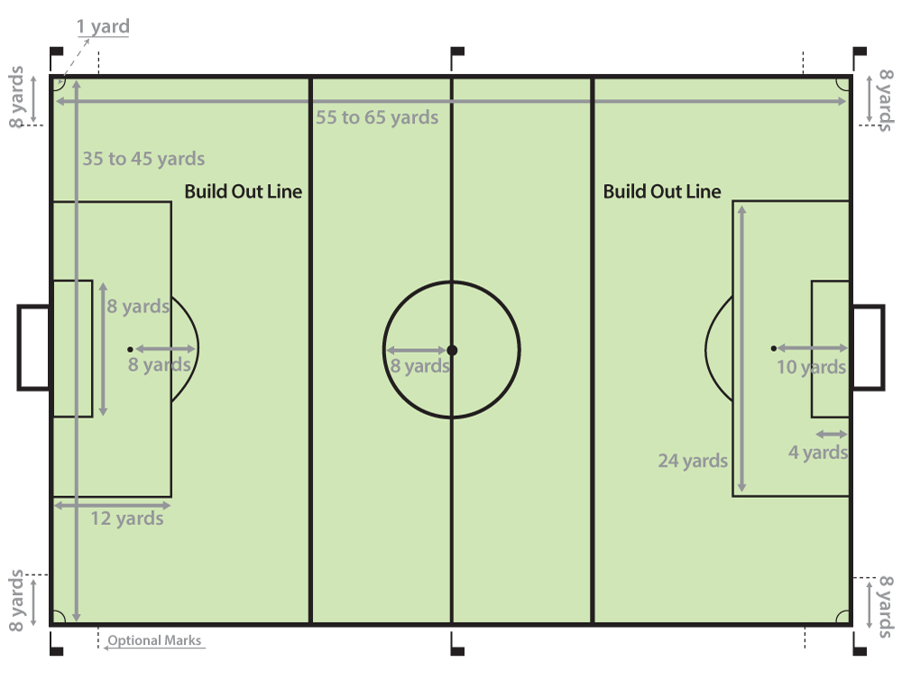
10u build out line
Build Out Line (designed to promote playing the ball out of the back in a less pressured setting):
Goal-kick or GK possession
Opposing team moves beyond
build-out line
Ball into play, game on
Also denotes offside line
No GK punting

Slide 12
12u Guidelines
9 Players per team (1 is GK), 14 on roster
Size 4 Ball
Match: Two equal halves not to exceed 30-minutes each.
Halftime shall be a minimum of 5 minutes and a maximum of 10 minutes. No added time.
Rules (at all times respect the decision of the officials):
  Corner kick; Goal kick
  What’s in and out of play
  Don’t kick or trip others
  No handling the ball
  No heading. Reminder there is no heading allowed until 14U. If a player in 10U or 12U deliberately heads a ball the result is an indirect free kick from the spot of the header.
  Yes Goalkeeper punts
  Offside at the middle line!

Slide 13
14u Guidelines
11 Players per team (1 is GK), 18 on roster
Size 5 ball
Match: Two equal halves not to exceed 35-minutes (14U) and 40-minutes (19U) each. We do not play 45 minute halves at19U because that would be longer than NY varsity games!
Halftime shall be a minimum of 5 minutes and a maximum of 10 minutes. No added time.
Rules (at all times respect the decision of the officials):
  Corner kick; Goal kick
  What’s in and out of play
  Don’t kick or trip others
  No handling the ball
  Yes heading
  Yes Goalkeeper punts
  Offside at the middle line!

