Slide 1

Hillcrest Core Soccer
1st and 2nd Grade
Coaches Guide

Slide 2
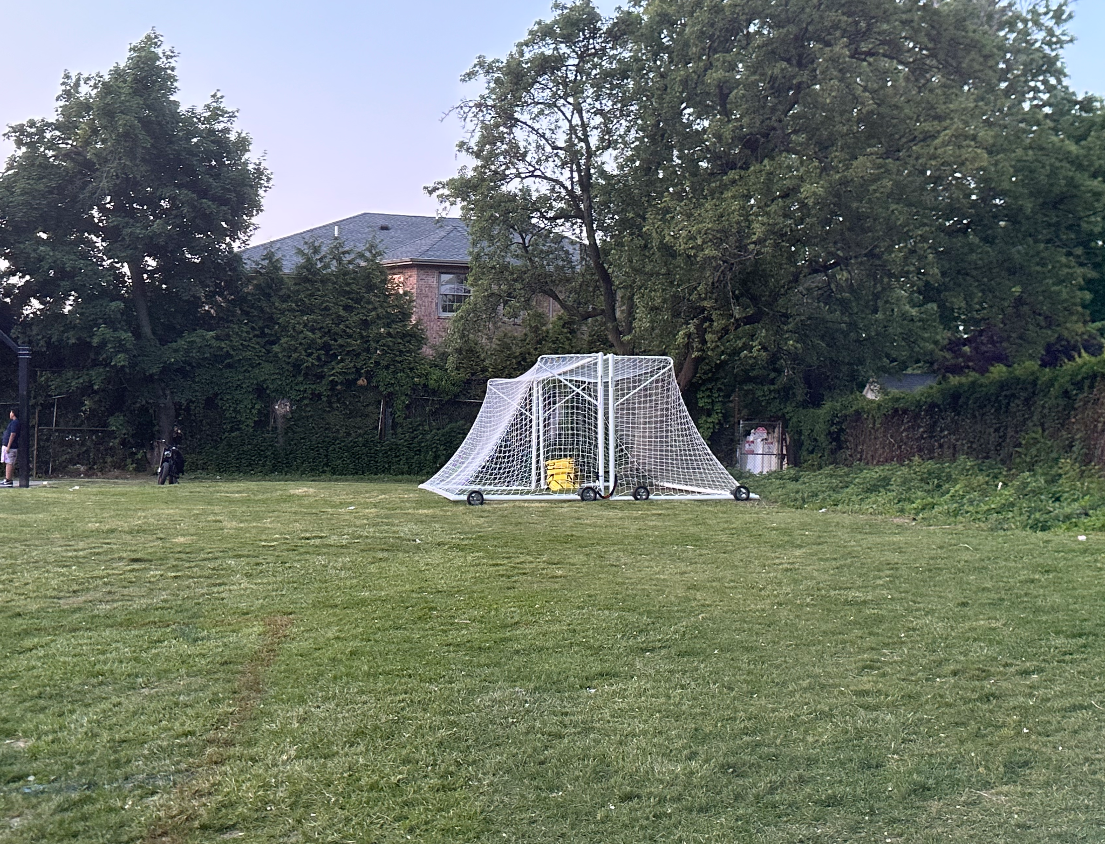
Code for the goals at Gibran is 1776. If you are the first game of the day at 10:30am, please arrive early to set up the field. The wheels of the goals are easy to wheel, but you have to flip them so they move. Please make sure all wheels are unlocked before moving so they do not break. Two teams start at 10:30am so please coordinate with the other team you are playing.
If you are the last game at Gibran (game starts at 1:30pm) then please move the goals back to their original position in the back right hand corner of the field. The goals should be locked into each other with the sandbags inside.
GOALS

Slide 3
TIME
It is very important to note that the time of your game is the START time of the game. Therefore, please have your team arrive at least 15 minutes early to warm up and prepare. We have referees scheduled and the games are back to back. You only have one hour on the field. Therefore, if you arrive late, your team will get less playing time.

Slide 4
Logistics
Please use a size 4 ball for games
Please have 7 v 7 (no more than 7 on a field for your team). You can go down to 6 v 6 if you are short on players.
The home team for each game is listed first on the schedule. For example, Team 1 v Team 2. Team 1 is home and should wear red jerseys (or a red shirt). Team 2 is the away team and should wear white jerseys (or white shirt).
Games are 12 minute quarters with a 1 min break between Q1 and Q2 for a quick water break, a 3 minute halftime, and a 1 min break between Q3 and Q4
There will be a referee assigned to all games
Ask your team for notice if they cannot attend. For example, I reach out to my team on Tuesday with that Saturday’s game time and ask my team to input their availability on the app by Thursday before each game. If you do not have the time to send these communications, you can delegate to another parent or the assistant coach on your team.

Slide 5
Logistics
This is a fun environment, please rotate subs as often as needed. Try to keep it fair for all players. Typically rotate every 4-6 minutes, and keep track of who has been subbed. The numbers on our girls teams are low, so you may not have many subs. Because of this, you may need to go down to 6v6. Just communicate with the other coach.
Rotate goalies if players want. Some players want to be goalie, and you can keep them in longer, and some don't. Please keep this even if players do not want to play goalie.
If a team is winning by 4 or 5 goals, it is expected that the winning team will adjust their team to keep the score down. For example, remove a player, or play the best scoring player in goal/defense. We try to keep the score to no more than 6 goals. Please keep the losing team at 7 players though. Do not try to balance out the teams by adding more players (e.g. Don’t make it 8v7 or 8v6).
Throw Ins - If a player does not keep his feet on the ground during a throw in the ref will allow them to have a do over. (Instruct them the correct way for the do over.

Slide 6
Logistics
In u8 soccer we play a “build-out line.” This is so the keeper and defense have time to kick the ball out of defense without being attacked by the other team. Here is a description of the rule and a video to further explain. This will be part of the field setup each week.
NO HEADING at all - This is a US rule for under 10's. Here is a link if you want to read more about this decision.

Slide 7
Cancellations
If you are personally unable to make a game, please email your team and ask someone to fill in. Let them know the game will be cancelled unless someone steps up. Sometimes it takes a couple of emails. You all have at least one other parent on your team that volunteered to assist, so start with them and then reach out to others, if necessary.
If you are very short on players (like 3 or 4) please email the other team and maybe they can lend you a couple so the game can go ahead.
If the game cannot go ahead and you have to cancel (please try things above first), please email Danielle Casey and Kelly Murphy so we can notify the referees.
Weather cancellations - If there is a lot of rain, Gibran floods easily and games may be cancelled. Make sure to check the TeamSideline app. Please do not contact us as we get many emails/texts and calls about the weather. We make the decisions when necessary. Parents can check the Website for Cancellations as well.

Slide 8
Contact Information
Danielle Casey - dtcasey8@gmail.com or (845) 893-7641
Kelly Murphy - hillcrestlakersoccer@gmail.com or (914) 999-0432

